Slide 2
Ambientes Laborales Para las Nuevas Generaciones
Federico Bisetti, fbisetti@cisco.com
Territory Business Manager
Paraguay y Uruguay
Notes:
Change – Change can be an amazing and wonderful thing but also change can be a bit scary and daunting. There has been without a doubt phenomenal changes in the technology we use in the last 10 years, from smartphones, tablets, an app for just about everything and even wearable tech.

Slide 3
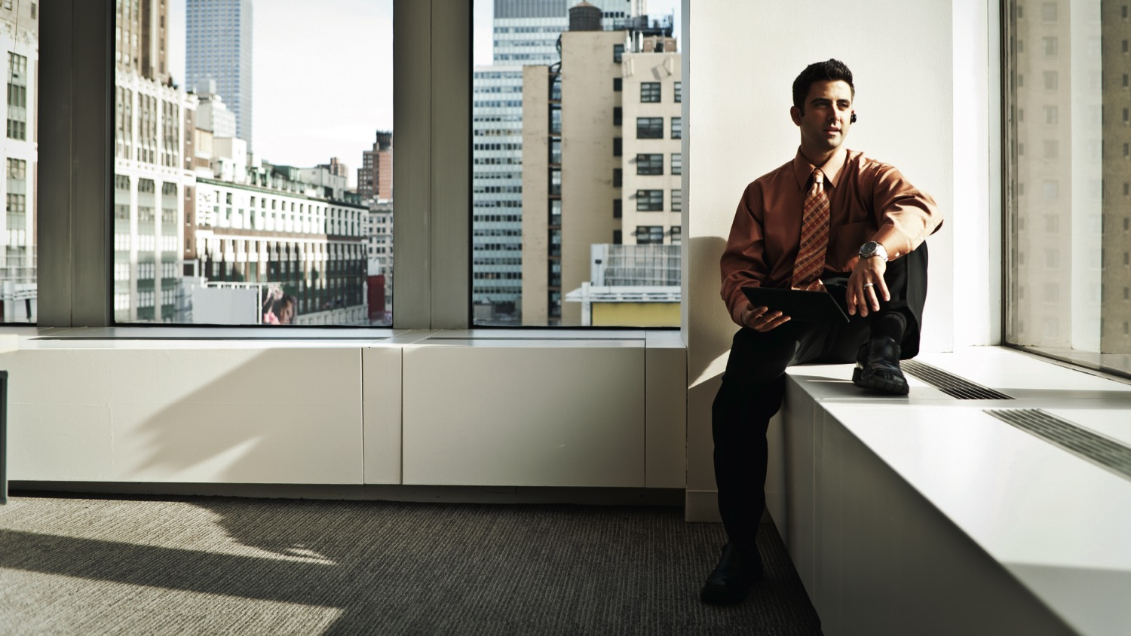











La Oficina Hoy - Desafíos
Demanda de más productividad
El desafío de Balancear
de los directores creen que el espacio de trabajo tiene un impacto en la productividad de los empleados
Costos de Propiedad
95.2%
Solo
mide como el espacio de trabajo impacta en la productividad
Utilización
30%
Cambiando las Expectativas
Gen X, Millenials >60%
Rápidos Cambios Tecnológicos
*source Gensler Corporate Real Estate Survey, 2013
Notes:
Shifting demographics
Evolving social contracts
Life work balance expectations
Consumerization
Remove geo boundaries

Slide 4
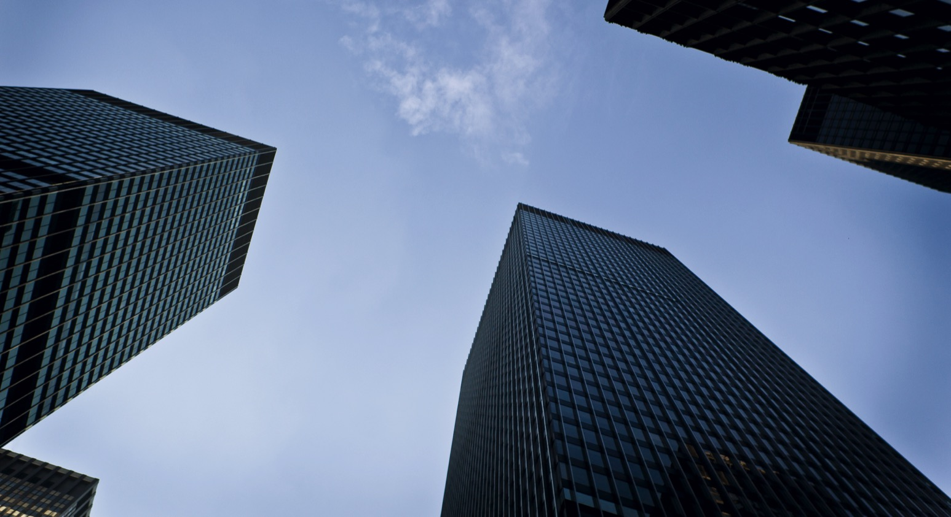
La Oficina Hoy - Preguntas
Como utilizar el espacio de trabajo para atraer y retener talentos?
Que hacer para que la oficina sea un acelerador de la productividad de los empleados?
Como medir la utilización actual la oficina para planear mejor?
Como optimizar los gastos de propiedad o alquiler manteniendo los niveles de satisfacción?
Como invertir sabiamente en las tecnologías y herramientas correctas?

Slide 5
Trabajo Flexible
Notes:
So companies have started to recognize that this sub-optimized asset, the workplace, needs to be optimized, and most have consolidation programs underway. This can be seen in the trends around the space allocated per employee, 3 years ago the average space per employee was around 225 SF, today it has dropped to 150 SF and it is projected to be sub-100 SF within 5 years. But consolidation is only part of the answer, companies need to transform the remaining space to support the emerging needs.
1. Attractive and appealing workplace for employees and visitors (attract & retain)
Have the specific capabilities to facilitate collaboration amongst occupants and the world beyond (inst. Knowledge)
Support Activity based working:
officially untie employees from their individual work area, offer “free seating” arrangements so employees can work near the people they need to
flip the ratio of individual and collaborate spaces, from 70/30 to 30/70, and offer spaces that encourage knowledge transfer and socializing.
offer a variety of workplace experiences that employees can choose from based on their work activities.
Deploy a flexible, modular design that has the technical attributes to support a more elastic workforce, one that is able to adapt to future business opportunities.
4. Truly embody not only a new space design, but the combination of space, technology and policy.
The workplace of the future is a Connected Workplace that blends they physical and virtual collaboration capabilities. Seamless, user friendly, frictionless collaboration

Slide 6
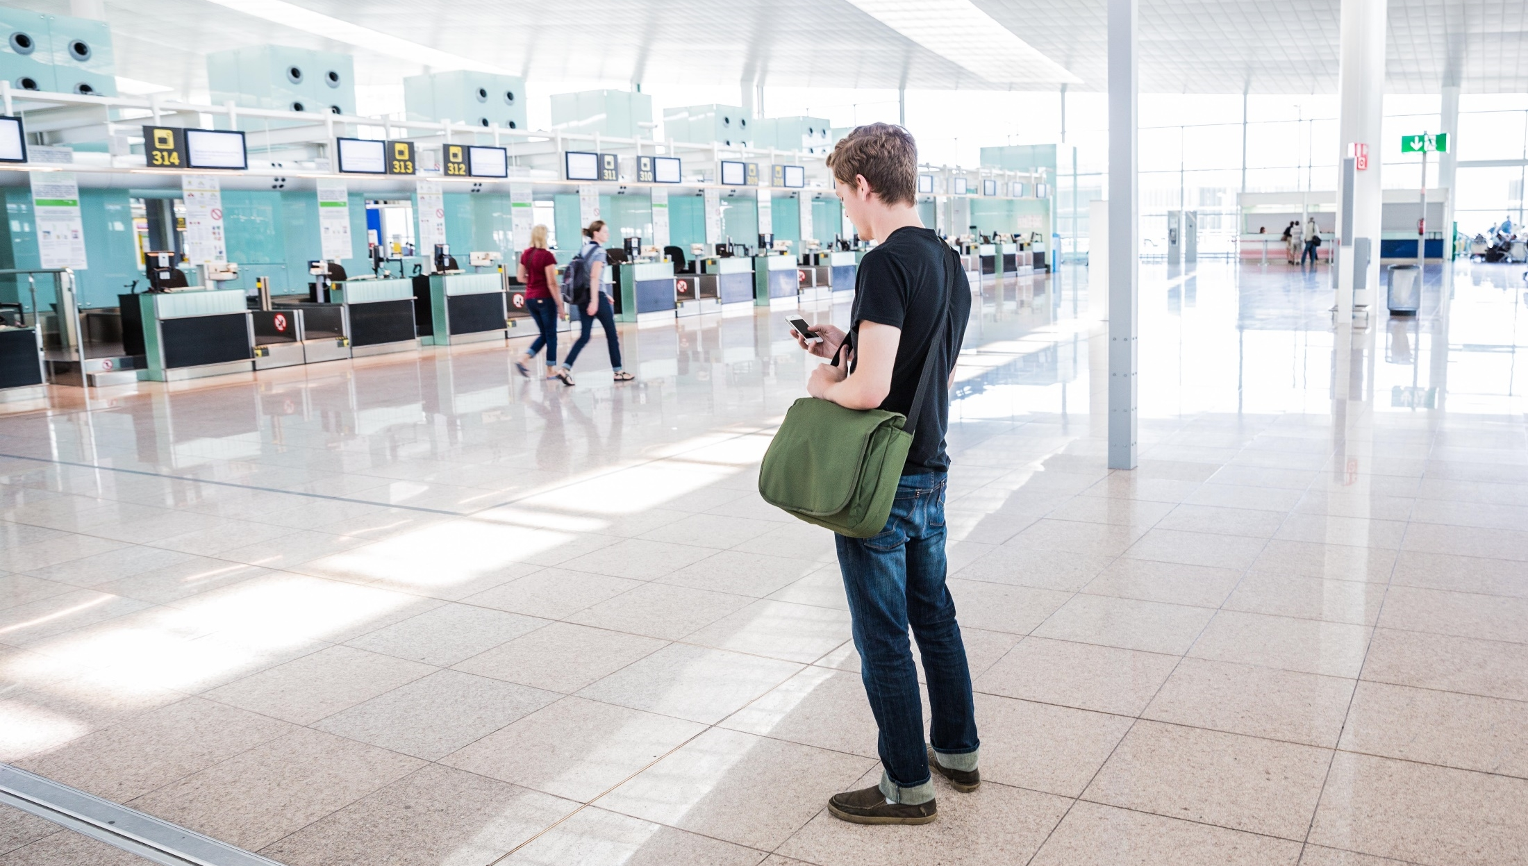





La fuerza más disruptiva en IT…
el usuario final
Notes:
It used to be that IT would distribute the tools that you would us at work and those were the tools you used. There weren’t other choices and most often those tools were more suited for business than what you had access to at home. Times have changed and now the combination of mobile and cloud have provided users with access to endless applications that can be used in the workplace. Today, if a user doesn’t like the tools provided to them by IT they can simply go to the App Store and download any number of applications. They have a choice now. This means that our workplace Collaboration tools must be designed so that they are just as delightful to use as all of the applications available to them in their personal life. The user has become the most disruptive force to IT.
The user has more power than ever.

Slide 7
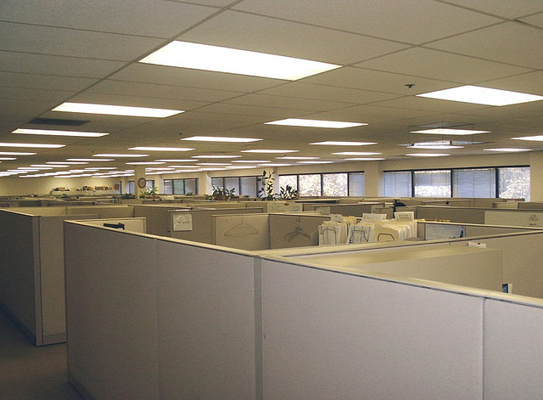
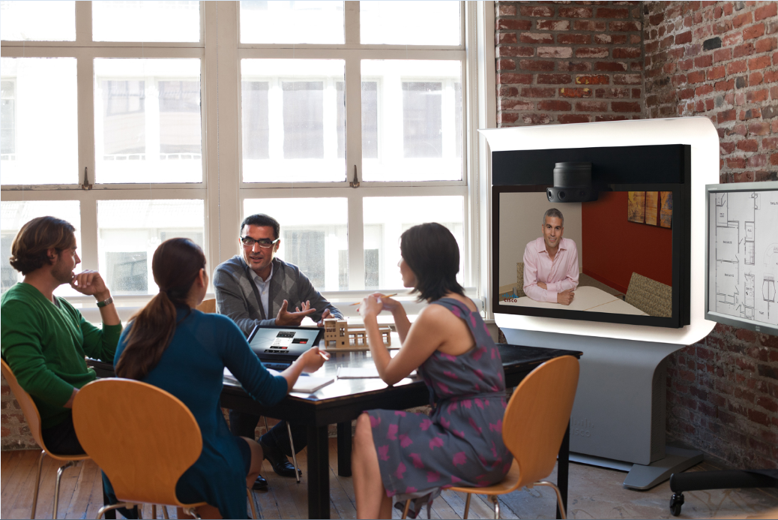
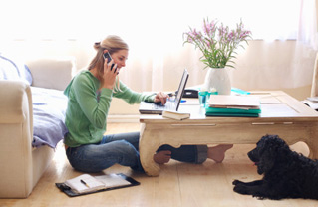
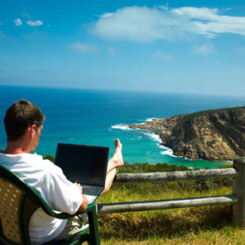
Un Día Típico
La Oficina Hoy
El Espacio de Trabajo Hoy
VS
El empleado del siglo 21 confinado a la oficna del sigo 20

Slide 8

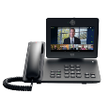

La Fuerza de Trabajo Necesita Más Flexibilidad
40%
40%
94%
de los empleados sera móvil para el 2016
de los usuarios de video usan 3 o más dispositivos para sus videollamadas
de los líderes de negocios opinan que la colaboración en la nube permite los ecosistemas de trabajo flexibles
Notes:
Which trend is missing?: more meetings than alone working. Working with external people.
As employees are becoming more dispersed and mobile, they need freedom in how and where they work to be truly effective. But it’s not just about devices and locations.
Executives still consider in-person collaboration an imperative. And far beyond the executive suite, organizations are realizing that the use of rich video communications has the power to transform the way we collaborate.
It’s about making providing all the tools people need to engage, everywhere and in every way they need to do it.
[PRESENTER: Use the following stats as appropriate.]
Anytime, anywhere workers in the US and Europe grew from 15% to 29% of employees between 2011 and 2012; 53% use multiple devices. (Forrester, 2013)
A recent Gartner study reveals that 2 out of 3 employees use personal devices at work. (2013)
By 2017, half of employers will require employees to supply their own devices for work (Gartner 2013)
Cloud is changing the way people access collaboration technologies. Both business and IT leaders are looking to roll out services faster and boost business agility, while shifting CapEx to OpEx. Employees are demanding cloud-based apps. A “bring-your-own-app” (BYOA) trend is furthering the evolution of BYOD.
93% of surveyed business leaders say cloud-based collaboration stimulates innovation. (Forbes, 2013)
91% say that cloud-based collaboration enables greater cooperation with customers. (Forbes, 2013)
Gartner predicts continued strong growth in public cloud services with a CAGR of 17% from 2011. (Forbes, 2013)

Slide 9
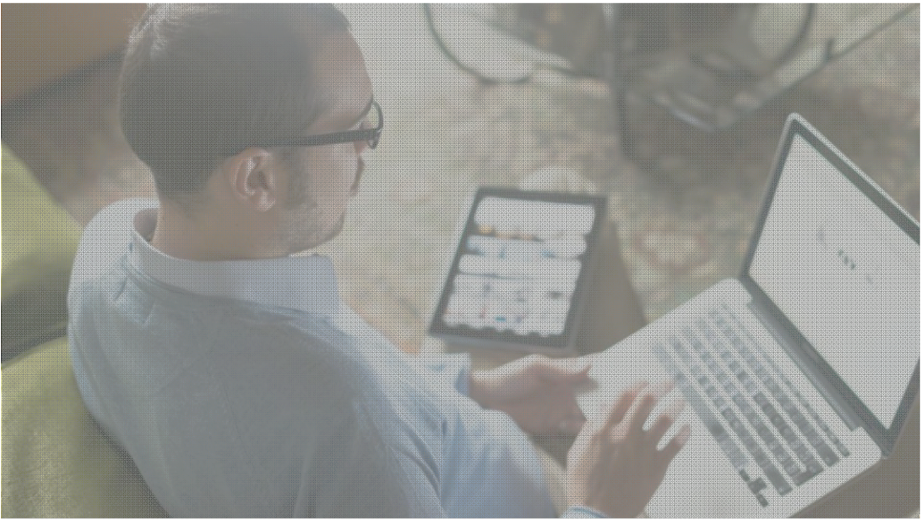

Factores más importantes para los espacios de trabajo?
Costo de propiedad y el promedio de ocupación
Fuerza laboral distribuida y la necesidad de acceso a multimples dispositivos desde cualquier lugar, y en cualquier momento
Disponiblilidad de espacios de Colaboración adecuados
Cambio en la oficina para impulsar una cultura de trabajo agil
  Atracción y retención de las nuevas generaciones
Notes:
Sub-optimized Real Estate utilisation
(40% average occupancy)
Lack of Adequate Multi-party Collaborative Spaces
Ability to attract/retain current and future talent
Gaps in innovation/responsiveness

Slide 10
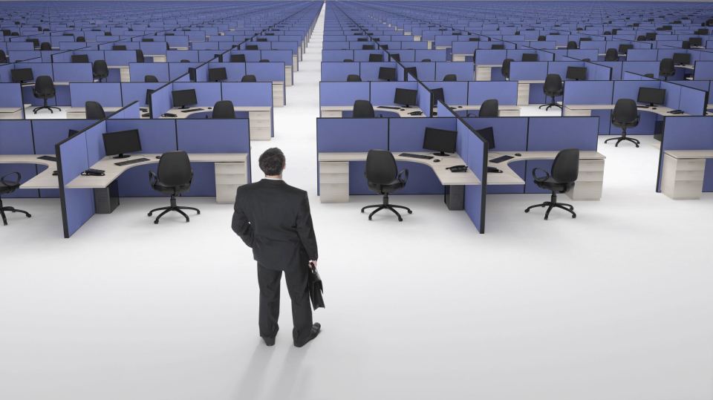
Necesitamos una Oficina que
Mejore la colaboracion y la productividad
Notes:
Sub-optimized Real Estate utilisation
(40% average occupancy)
Behaviour
Important to be seen in the office mentality
Leaders lack the support to run flexible teams
Negative perceptions of flexible working & BYOD
Environment
Inefficient use of workspaces
“Workspace improvement” is often raised as an issue
Lack of collaborative and flexible working areas

Slide 11
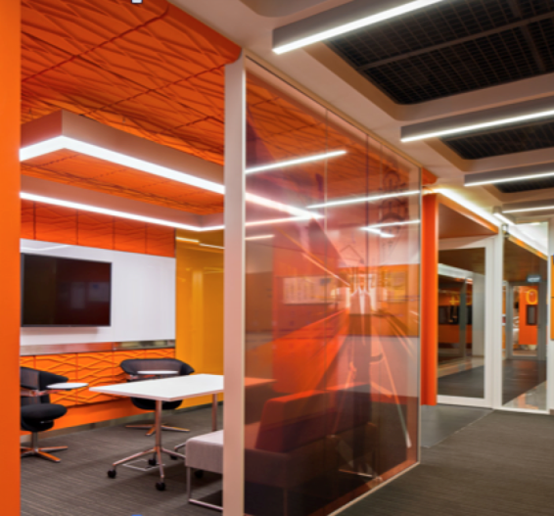
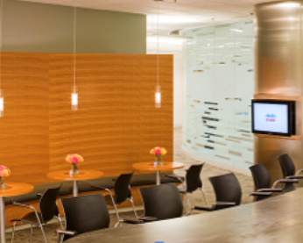
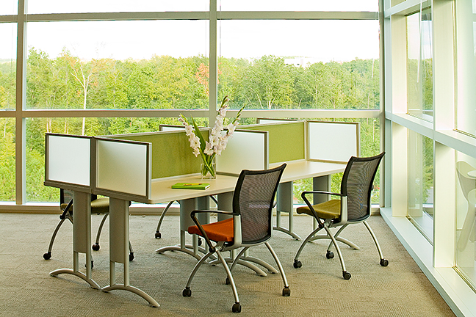
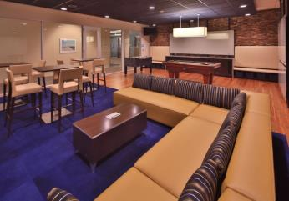
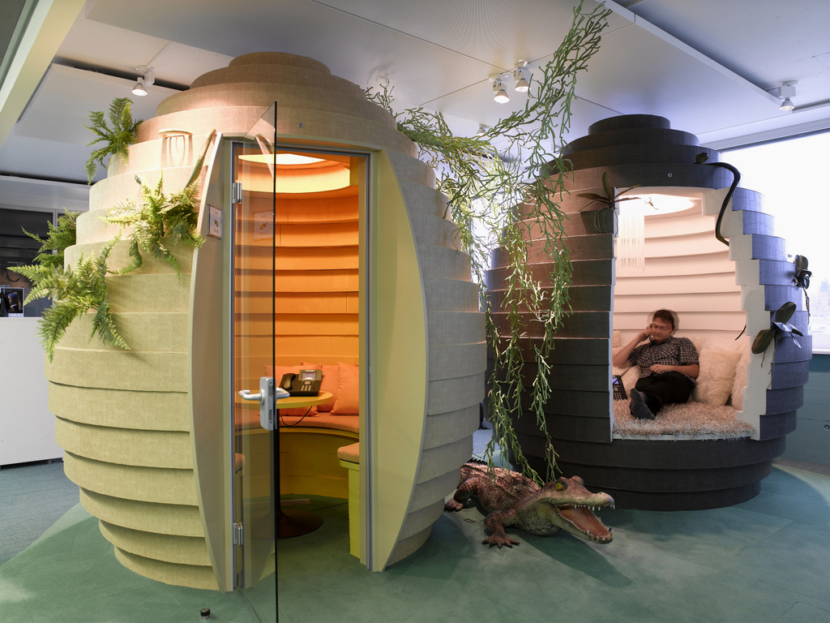
Nuevo Paradigma de diseño - Activity-based Working (ABW)
Crear variedad de espacios de trabajo alineados a las actividades que se llevan a cabo
Notes:
Transforming physical space to more collaborative space for professionals could drive positive social and environmental change
Employees are empowered with the freedom to choose different types collaborative tools and work settings to suit various types of work activities.
So what are companies doing? They are optimizing their real estate portfolios where necessary, and transforming their remaining space to meet the challenges of the new work environment. They are moving away from the traditional cubicle centric office layouts, and embracing a new design principle called Activity based Working. Please don’t confuse this with hot desking or hoteling. Although unassigned seating may be part of an ABW environment, it is not a hard rule. The real goal is to offer employees a variety of workplace experiences that are specifically aligned with the activities being performed. And what are those activities, employees need workspaces to concentrate, collaborate, learn and socialize.
Here at Cisco we call this Cisco Connected Workplace, or CCW. We have standardized on approximately 30 distinct workspace types that are the building blocks on how we create our workplaces. To date, about 40% of our offices have already been transformed, and our executives have declared that going forward every new office will embrace this design principle

Slide 12
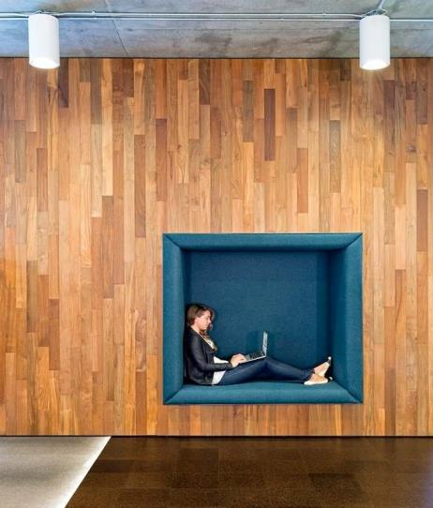
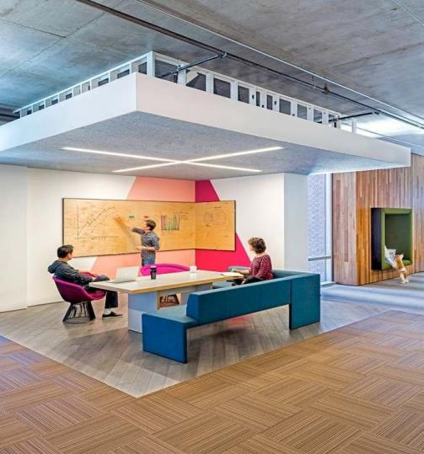
Tener espacios de trabajo disponibles, cuando y donde los empleados los necesiten, a demanda
Espacios de Trabajo
Inteligentes + Conectados
Reune y combina los aspectos virtuales y fisico de los espacios de trabajo
Optimiza el espacio y los recursos de la oficina
Mejora la intercomunicación
Provee detalles de las conductas de los empleados, ocupación de los espacios y colaboracion
Disminuye los costos de energía
Entrega aplicaciones para entrenamiento, anuncios, publicidad y emergencias
Notes:
Here is some examples of the worker roles and styles that have been identified in Cisco, they are designing all new offices and refurbish old cater for this….
Roles like – workstation anchored is not going to completely disappear, there are job roles that require an individual to do task oriented work for around 8 hours
The larger majority of knowledge works fall into categories like – remote collaborator, mobile workers either campus mobile and highly mobile and those neighbourhood collaborator

Slide 13




El Rol de la Tecnología en la Tranformación del Espacio de Trabajo
“Conectar lo desconectado” y unificar los espacios de trabajo fisicos con los virtuales.
Permitir la flexibilidad, personalización y elección.
Mejorar el management, control y visibilidad de los recursos.
Mejorar la experiencia de los empleados, proveedores, clientes y visitas.
Notes:
All these technologies enable workplace transformation – they enable new and great experiences for employees and guests to the organisation
When we talk about connecting we’re talking about connecting people – and this means people, not endpoints.
It also means any media, any device, any time and space, independent of technology mandate.
This is about the inclusion of people through the abstraction of complexity .
The opportunity is to transform the organization by connecting all people
We need to marry up the physical with the virtual -
Collaboration is key –

Slide 14
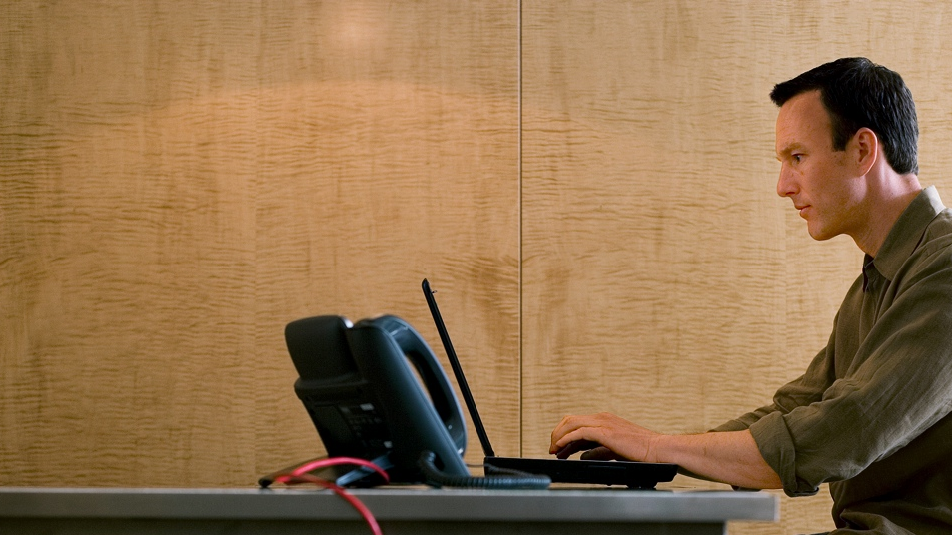







Espacios de Trabajo Inteligentes y Conectados
Trabajar en cualquier lugar, acceder desde cualquier lugar
Personaliza mi espacio
Sabe donde estoy
Mejora mi productividad
Me proteje a mi y a mi información
Me da opcciones
Me ayuda a colaborar mejor
Mejora mi balance Vida / Trabajo
Notes:
If you want to successfully transform the workplace then you need easy and seamless ways your users can interact with the physical spaces and technology available, the users need choice, the technology should not restrict, users should not be bound by a single option. Users want personalisation, location information to know where there collaeagues are and also tools that allow them to be more productive and collaborate with others internally and externally. Users want a flexible working environment seamlessly moving between personal and professional domains whether at home or in the office.
The smart Connected Workplace does just this......

Slide 15


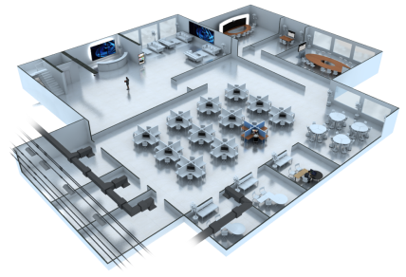


Ubicuidad de Wi-Fi
y BYOD
Carteleria Digital y Servicios para visitas
Workplace Analytics
Video Colaboración Inteligente
La Oficina Inteligente y
Conectada
Espacios Inteligentes
Acceso a la red unificado
Servicios de identificación y seguridad
Colaboración Personal
Manejo y control de la energía

Slide 16
La colaboración permite la transformación
Comunificaciones
Unificadas
Conectividad y Federación
Reuniones en cualquier momento con cualquier dispositivo
Dispositivos de HW y SW para colaboración

Slide 17
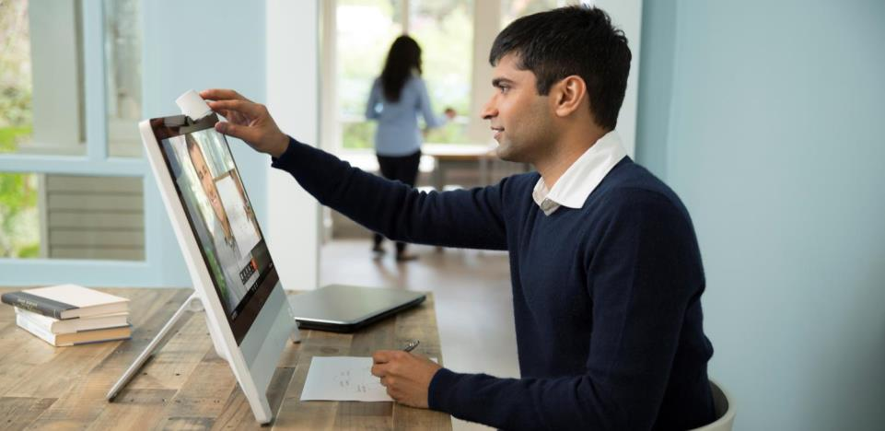
El impacto del video en la tranformación de los espacios de trabajo
60%
Mejora en la performance de la conversacion y la productividad
73%
Terminan más rápido
100%
Coincide que acelera la toma de decisiones

Slide 18
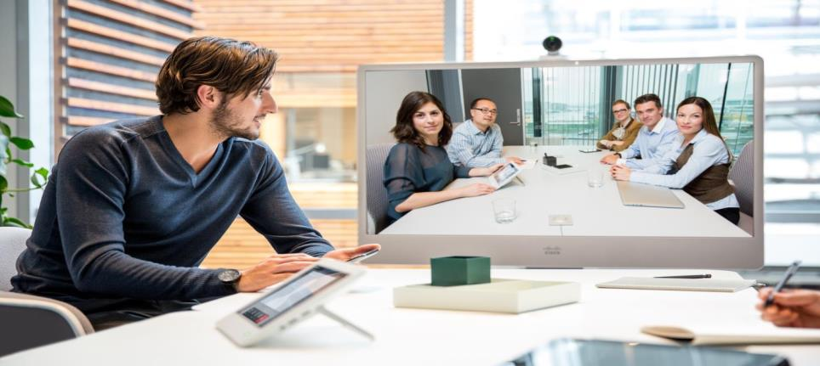

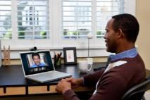
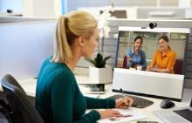


Conectando a los empleados virtuales o remotos
Productividad a través de las reuniones virtuales
Promoviendo Resultados
La colaboración full impulsa la innovación espontánea.
Video, voz y colaboración web B2B con seguridad
Notes:
Pmr y cmr….
Organizing your time, not your technology

Slide 19
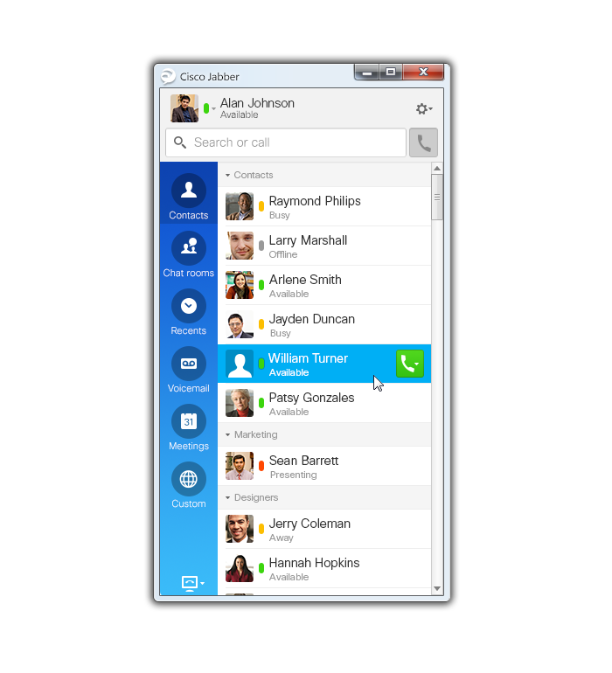
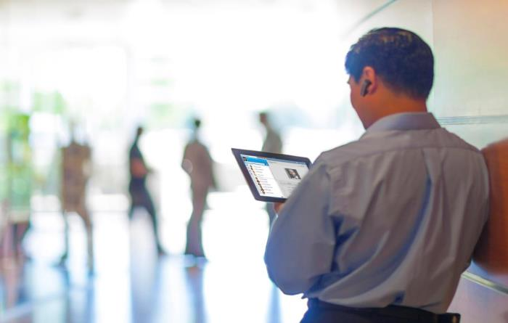

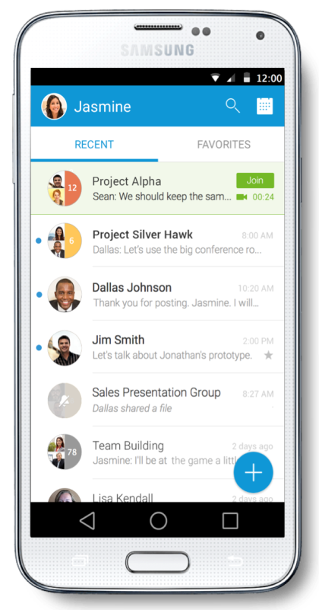
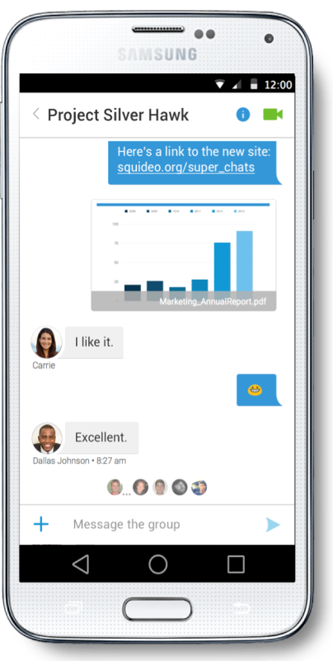
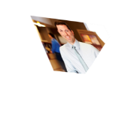
Trabajar desde cualquier lugar como si estuvieran en la oficina
Mejorando Resultados
Potenciando trabajadores moviles
Experiencia que se adapta a cualquier lugar y desde cualquier dispositivo
Facilidad en el paso de colaborar por chat, a voz, a video o a colaboración Web
Trabajar en un cliente, proveedor, casa o lugar público

Slide 20
(re)Diseñando los Espacios de Trabajo

Slide 21

Rediseñando la oficina
Notes:
Mas espacios comunes que de oficinas particulares….

Slide 22
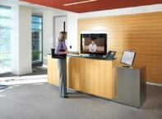
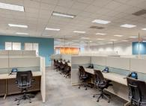
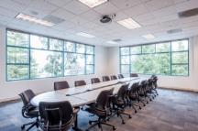
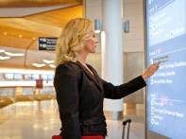
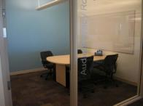
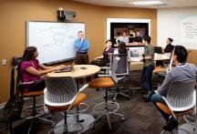
Tipos de Espacios de Trabajo
Espacios Personales o grupales
Espacios Comunes
Espacios de Colaboración
Diseño y % de Iteraciones
Notes:
22

Slide 23

Rediseñando la oficina
Espacios Comunes
Espacios Colaborativos
Espacios
Personales o
Grupales

Slide 24


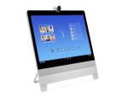

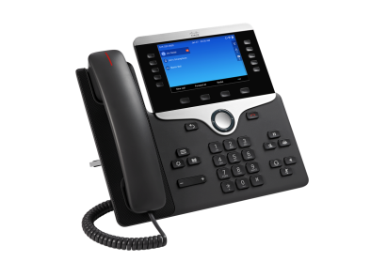


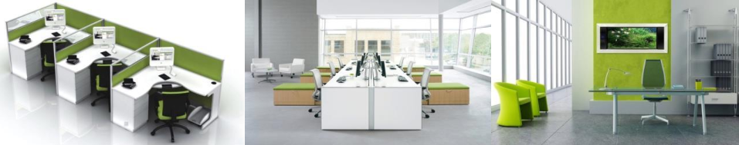
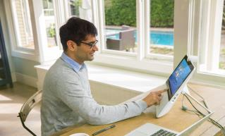
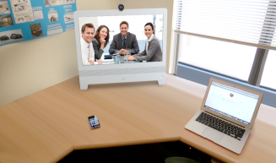
Espacios de Trabajos que favorecen la Colaboración
8800
DX650
DX70
DX80
Spark
Jabber

Slide 25
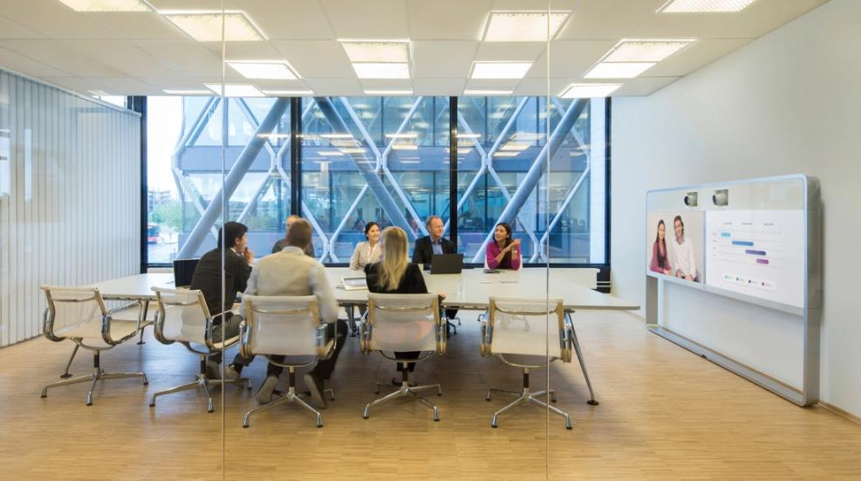
Salas con Colaboración

Slide 26

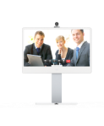
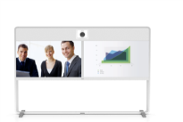
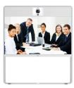
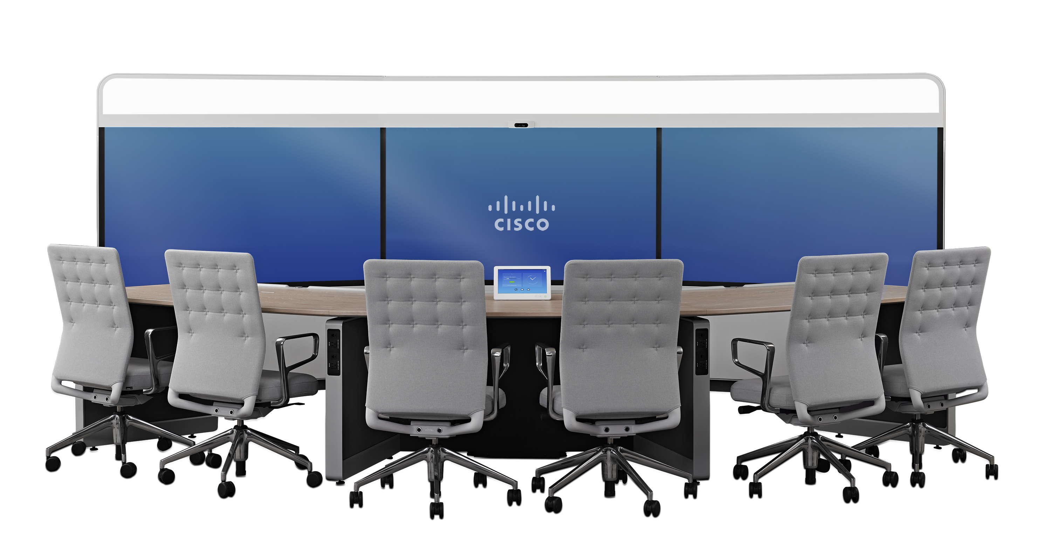










Salas con Colaboración
Un dispositivo para cada espacio de trabajo
MX200 G2 – 42’’
MX300 G2 – 55’’
MX700 – 55’’
MX800/D – 70’’
IX5000 – 70’’
Quiet Room
Small Room
Medium Room
Large Room
Training-/Board Room/
Auditoriums
Immersive Room
SX10
SX20
SX80
IX5000 – 65’’

Slide 27
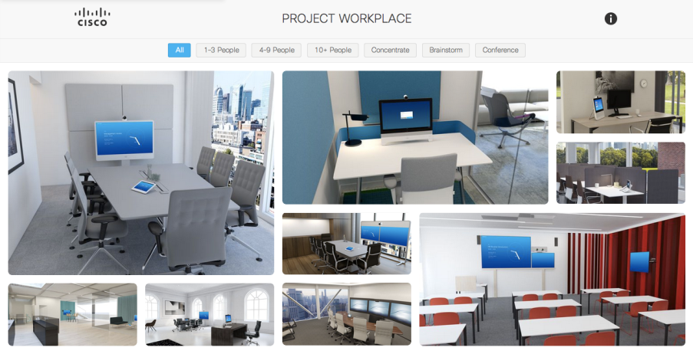
Project Workplace cisco.com/go/project workplace
Experience-
Centric
Cloud
Connected
Value
Extended

Slide 28
Experimentando los espacios de trabajo

Slide 29





Move seamlessly from
the Browser to the Boardroom
Browser
Mobile
Work Office
Small Group Spaces
Larger Spaces
Boardrooms
SEAMLESSLY!
Notes:
….

Slide 30

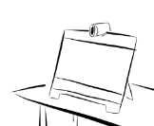


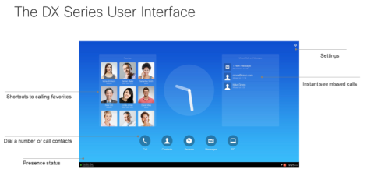
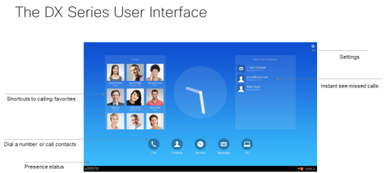
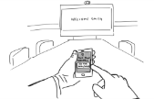


Bobs Morning ABW
Select space
Login to all apps
Use / Work
Logout
Move to next space
Login (with prefs / hist)
1. Select suitable space
2. Login to all key capabilities
3. Including profile and history
Bob needs to do some focused work, his email, finish a report and return some phone calls
Bob needs to access email, IM, his calendar, voice / video for calls and join a webex
Bob needs to return call he missed searchs for the number in history, he also calls a frequent contact
4. Logout Out
5. Move to meeting space
6. Move back to focused workspace
7. Login to all apps and history
Bob sees meeting reminder for team meeting so logouts out to move to multi-party video room as team members will join him
Bob and team join meeting and access meeting content
Bob now needs to finish those emails and the report and finds the space he used earlier occupied chooses new space and logs in
Bob still needs to return a few calls so accesses history / recents and contact favourities
30

Slide 31
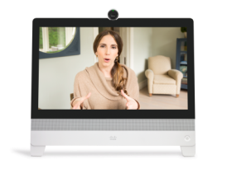







Proximidad Inteligente para Voz Movil
Experiencia mejorada en el escritorio
Acceso a los contactos y rediccionamiento de llamadas
Phone Book Sync
Call History Sync
“Handsfree” Audio

Slide 32

Cisco Intelligent Proximity
Compartir contenido desde la PC desde cualquier lugar sin cables
Usar el telefono móvil como control remoto de la videoconferencia
Ver la presentación en tablets o telefonos
Guardar tomas del contenido en tu propio dispositivo
Ver el contenido previamente compartido
Notes:
Official support for Cisco TelePresence SX10, SX20, SX80, MX200 G2, MX300 G2, MX700 and MX800.

Slide 33

Llevar tu reunión a todas partes y a todos
Clickear en link or marcar una SIP URI…

Slide 34








Proximity and WebEx Mobile (Beta)
Supports CMR Cloud and Hybrid meetings
Transfer the WebEx meeting on mobile to a video endpoint
Active when in close “proximity”
Proximity app can control the audio
WebEx mobile app remains in the meeting, running in the background
1
2
3
WebEx Proximity gets video endpoint into CMR Cloud/Hybrid meeting
Documented in the KB article: http://kb.webex.com/WBX89076

Slide 35

En la oficina del futuro… una variedad de diferentes sistemas de mantenimiento y IT deben estar sincronizados
Agenda de Salas de Confernencia
Email y Calendario
Reserva de Escritorios
Reserva de Equipos
Acceso
Directorio de Empleados
Manejo de Visitas
Video Vigilancia
Sistemas de Colaboración
Sistemas de manejo de oficina
Otros Sistemas de IT
Sistemas del Edificio
Seguridad y Control de Acceso
Iluminación y Aire

Slide 36






Permitiendo la Flexibilidad
Herramientas para el manejo de la oficina
Integra cartelería digital, con Telefonía, con Video llamadas, con los sistemas de manejo del edificio
Personaliza el Espacio de trabajo
Mejora la experiencia en las reuniones, reduce consumos y aumenta la eficiencia de utilizacion de salas
Provee a los que manejan el real state analíticos con ocupación y utilización
Cisco Smart+Connected Meeting Spaces/Personalised Spaces

Slide 37

Espacios Inteligentes y Conectados
Achicando la brecha entre los espacios Digitales y los Fisicos
Encontrar Colegas
Encontrar Escritorios
Mobilidad Automatica
Colaborativos
Reportes de Control
Video llamadas rápidas
Sociales
Agenda de Reuniones
Reserva de Salas
Enfocados
Salas auto configuradas
Liberación de Salas
Salas con ahorro de energía

Slide 38









  Locación Dinamica de Espacios de Trabajo
Oficina Digital Cisco
  Reserva
  Localización
~23%
IT Capital
Spend
~40%
Lower Real
Estate Costs
  Experiencia
Temperature
Color
Blue
68°
~53%
Lower Furniture Costs
~35%
Energy Costs
74°
Intensity
High

